Slide 1
Unity Christian Fellowship, Inc
Education and Life Skills Program
November 19, 2022

Slide 2
Agenda
Opening Devotion and Introductions – Youth Leadership (11:00-11:15)
This Book Is Anti-Racist (11:15 – 11:55)
Recap of October meeting
Character Strong – Responsibility
Game (11:55-12:00)
Back To School Strategies – Ed Reed (12:00-12:20)
Game (12:20-12:25)
Announcements and Closing (12:25-12:30)

Slide 3
This Book Is Anti-Racist
What does anti-racist mean?
Who am I?
Should you compromise who you are?
What are your identities?
What qualities do you have that make you a part of a group?

Slide 4
Who Am I
Anti-racism is actively working against racism.
Racism is prejudice, discrimination, or antagonism directed against a person or people on the basis of their membership in a particular racial or ethnic group.
You are everything within you and everything around you. It creates your identity.
Character
Gender
Appearance
Etc.

Slide 5
Character Word for the Month
What does respect mean in your own words?
Respect

Slide 7
Perspective Taking
The ability to put ourselves in the place of someone else while recognizing their point of view, experience and beliefs.

Slide 8
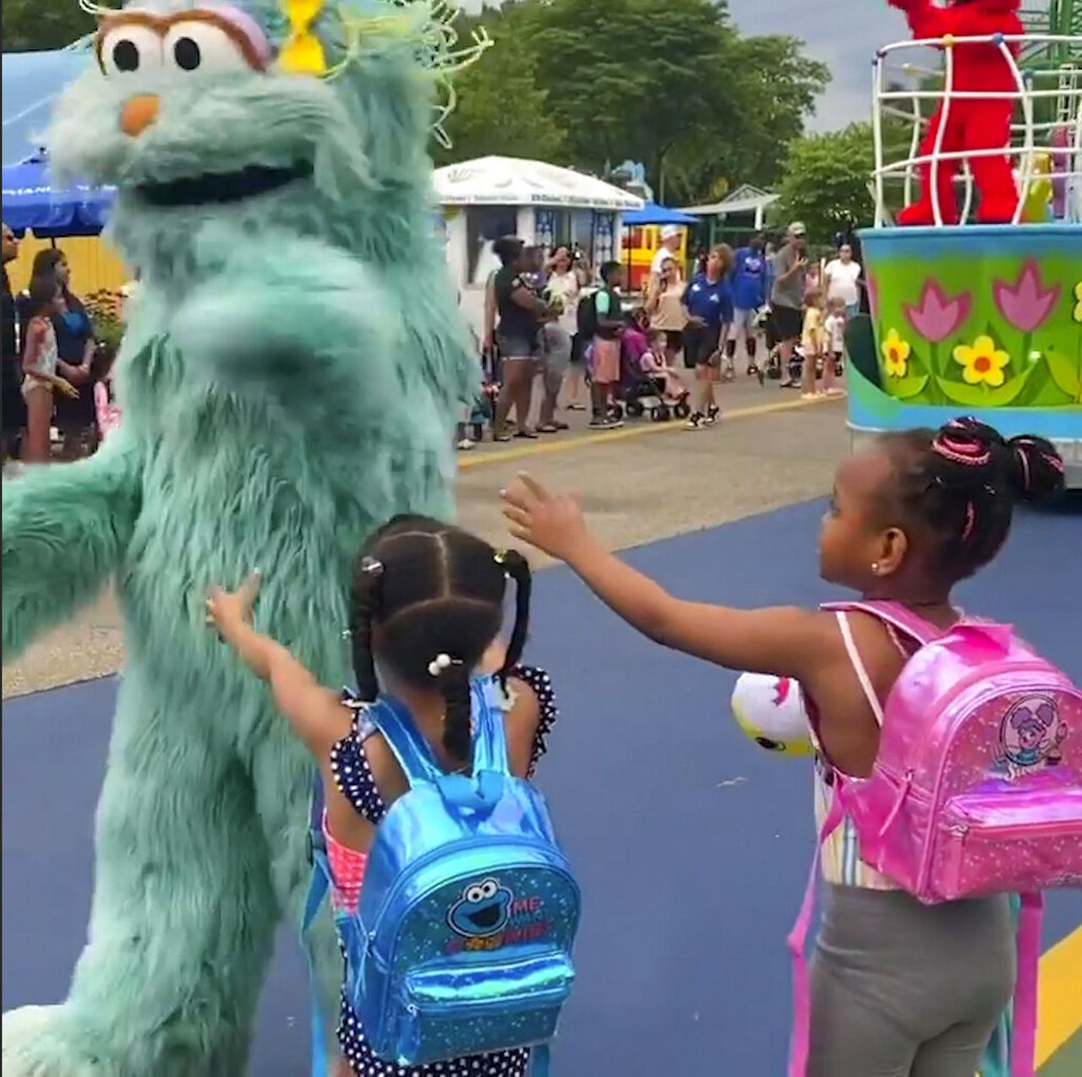
Sesame Place Racism
$50 Million Class Action Lawsuit
filed by 89 families with 125
children involved.

Slide 11
Game - Pictionary

Slide 12
Character Word for the Month Responsibility
A big part of Responsibility is how we interact with, or engage with, others. As we work to keep healthy relationships, we must understand that our choices impact those around us. This month's focus for Character Strong is on Responsibility when goal-setting.
Responsibility is taking action and understanding the impact of our choices.

Slide 14
Mountain TOP
Have you ever climbed to the top of a mountain or hill?
How would you describe the experience?
Today’s Objective
We will explore TOP Goals and create a Mountain TOP Goals poster.

Slide 15
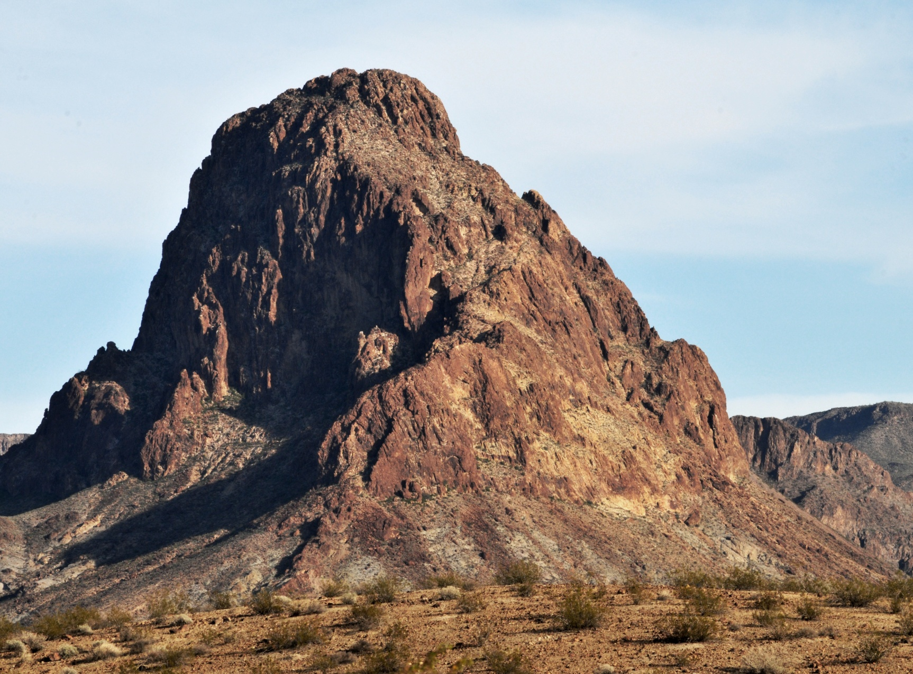
Top
Obstacles
Plan
GOALS
This Photo by Unknown Author is licensed under CC BY

Slide 16
Goal Setting
Let’s compare a mountain-climbing to goal-setting using these sentence stems:
The view from the top of the mountain is like _________.
A boulder blocking the path is like __________________.
The trail map is like ________________.
The TOP Goal model has 3 parts:
Target: Choose a goal and then visualize what it would feel like to succeed.
Obstacles: Plan for challenges. If ________gets in the way, then what can you do?
Plan: Create 3 action steps you will need to take to complete your goal.

Slide 17
Steady
Draw a target at the top on the mountain and label it Target.
Draw a winding trail from the bottom of the mountain to the target.
Think about it: How might it feel to reach the top of a mountain after a climb?
Around your target at the top of the mountain, choose and write 3 words that describe how it might feel to reach the top.
Decorate your paper with colors and images that reflect your emotion words or the view from the top!

Slide 18
Reflect
How are Responsibilities and goals-setting related?
What do you think is the most helpful part of the TOP goals model? Explain your thinking.
Have you been successful in achieving your goals in the past? Explain why or why not.

Slide 19
Game - Pictionary

Slide 20
Announcements
January 16, 2023 -MLK Day of Service, Silver Spring Civic Center
February 25, 2023 – Community STEM Day, Rocky Hill Middle School
April 2-5, 2023 – Dream Chasers ColleHge Tour
Game Changer Conference – TBD
Homework Club – TBD
Home Improvement Program - TBD

