Slide 1
Unity Christian Fellowship, Inc
Education and Life Skills Program
October 15, 2022

Slide 2
Agenda
Opening Devotion and Introductions-Youth Leadership (11:00-11:15)
This Book Is Anti-Racist (11:15-11:45)
Who Am I
Character Strong
Vision Board
Game (11:45-12:10)
MLK Day of Service Project (12:10-12:20)
Announcements and Closing (12:20-12:30)

Slide 3
This Book Is Anti-Racist
What does anti-racist mean?
Who am I?
Should you compromise who you are?
What are your identities?
What qualities do you have that make you a part of a group?

Slide 4
Who Am I
Anti-racism is actively working against racism.
Racism is prejudice, discrimination, or antagonism directed against a person or people on the basis of their membership in a particular racial or ethnic group.
You are everything within you and everything around you. It creates your identity.
Character
Gender
Appearance
Etc.

Slide 5
Character Word for the Month
What does respect mean in your own words?
Respect

Slide 7
Perspective Taking
The ability to put ourselves in the place of someone else while recognizing their point of view, experience and beliefs.

Slide 8
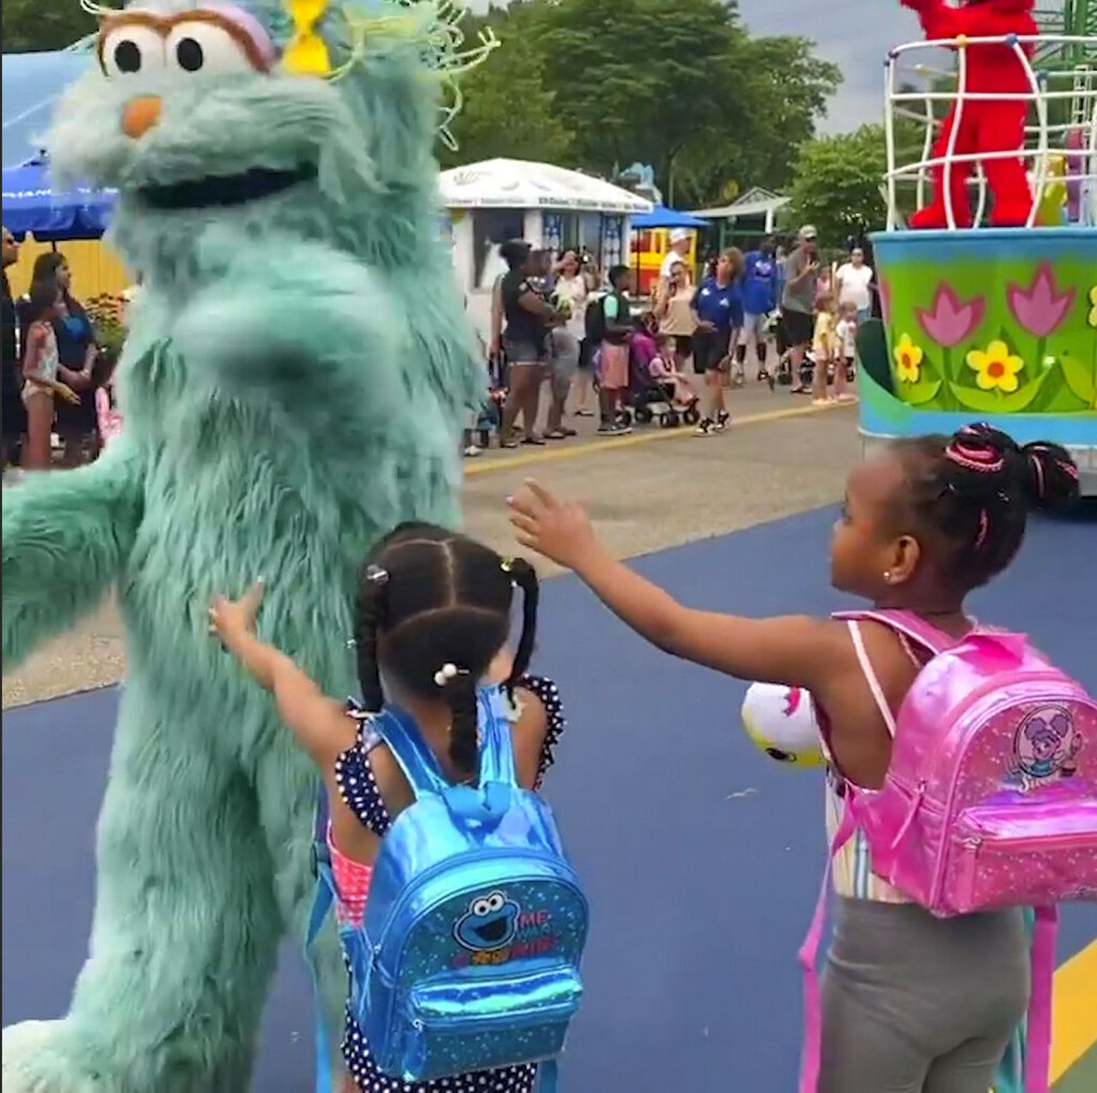
Sesame Place Racism
$50 Million Class Action Lawsuit
filed by 89 families with 125
children involved.

Slide 10
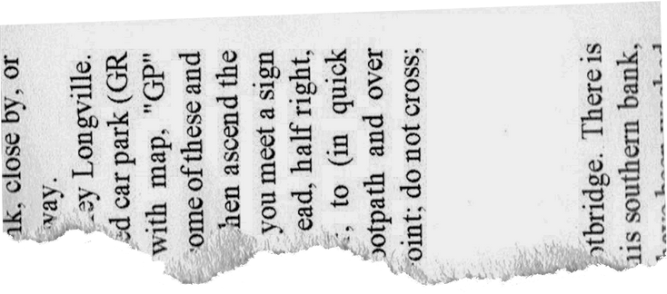
Who Am I
Southern Black Female
Daughter
Sister
Mother
Grandmother
Laid Back Reserved Servant Leader
r
I
e
M
t
a
t
t
a
t
M
e
MY IDENTITIES
I
r
r
I
e
M
t
a
t
t
a
t
M
e
I
r

Slide 11
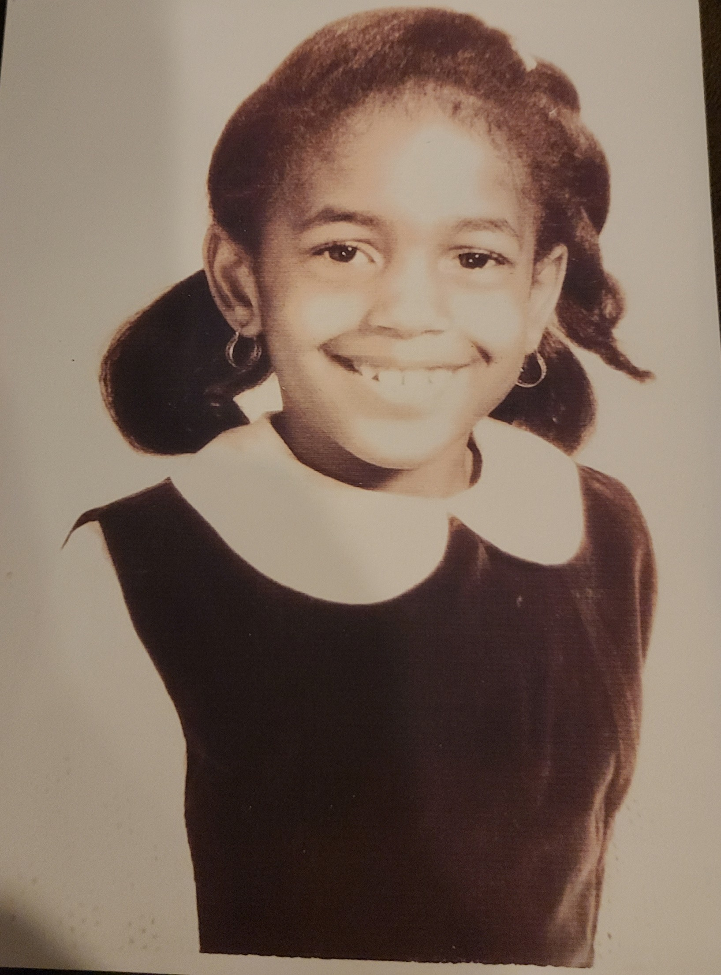
Quiet
Extended Household
1 of 11 black students in my school because of integration
Poor

Slide 12
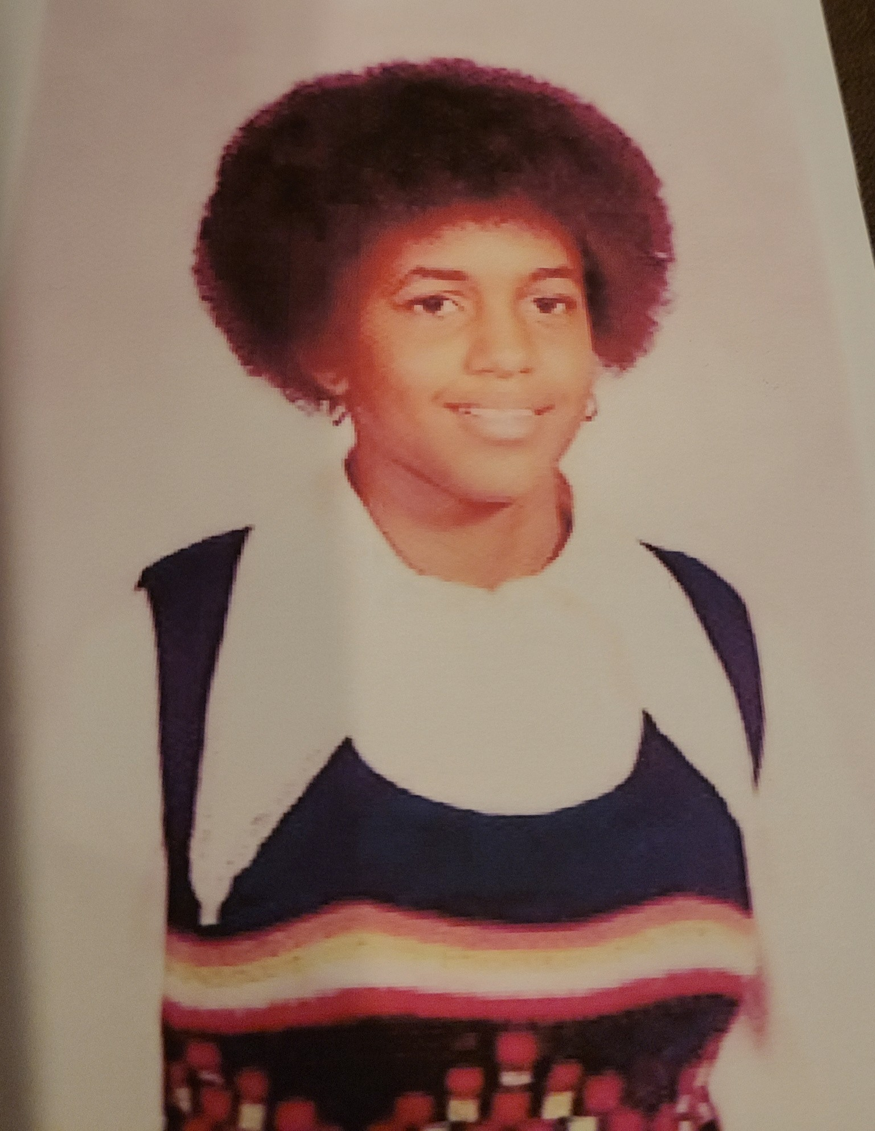
More Confident Circle of friends widened
Competed with classmates
to make the best grades until high school Sheltered introvert Participated in a team sport (basketball) Labeled a leader because of the way I carried myself

Slide 13
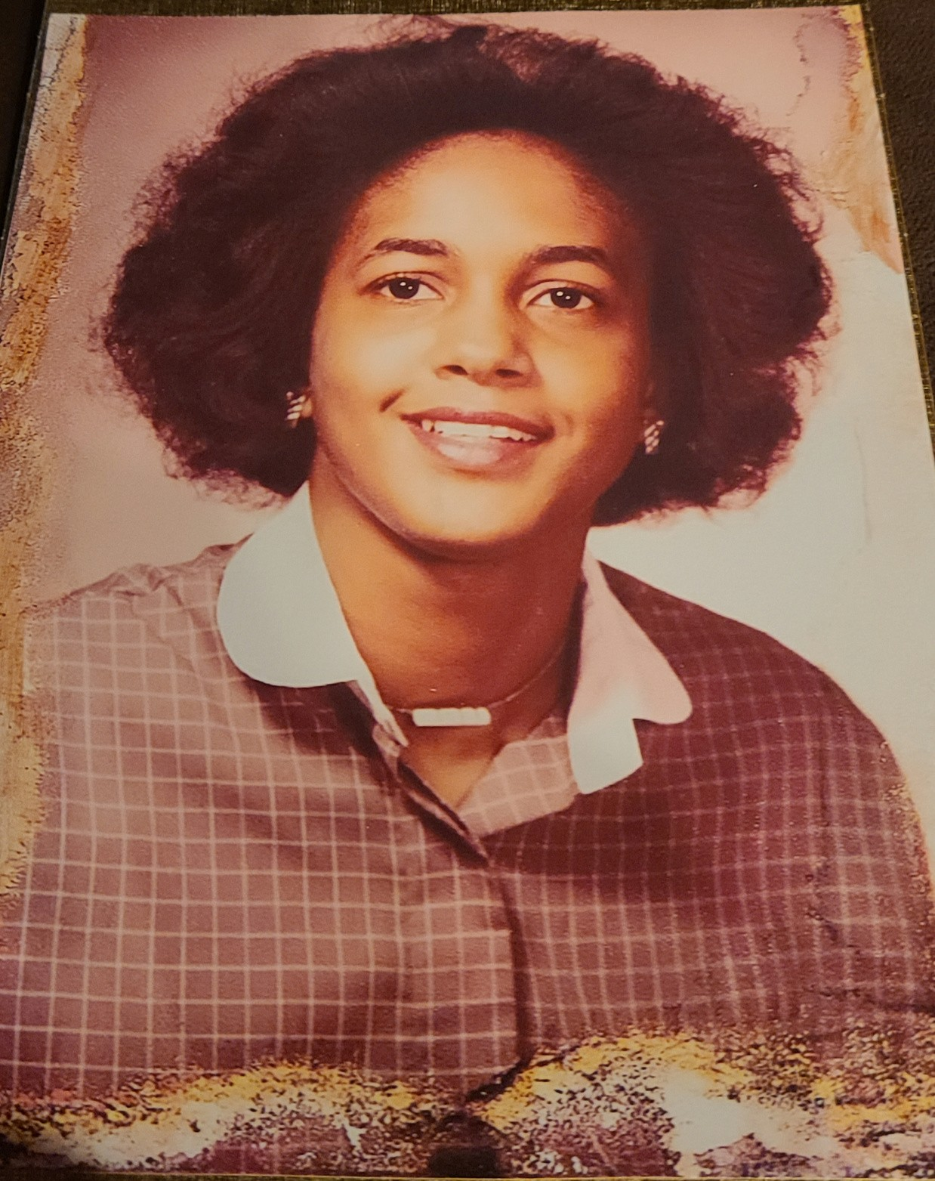
Determined to graduate from college
Determined to make a better life
for myself
Determined to have a career Determined to tour Europe Determined to own a sports car Became a member of Delta Sigma Theta Sorority, Inc.
Circle of friends widened even
more
Still very laid back Learned a lot about myself

Slide 14
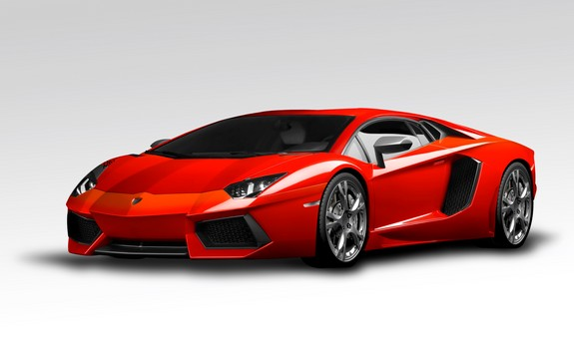
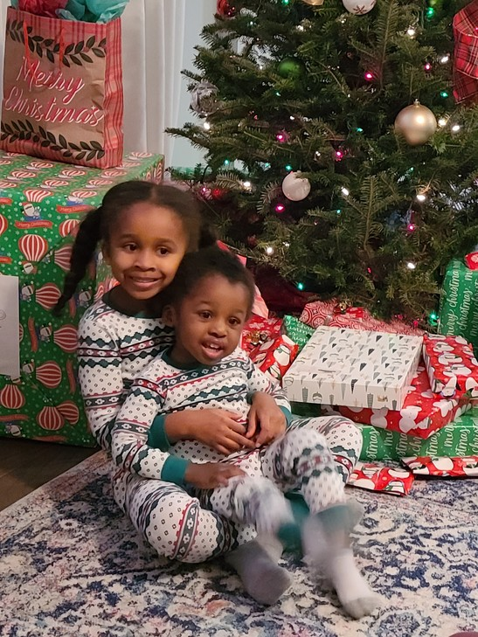
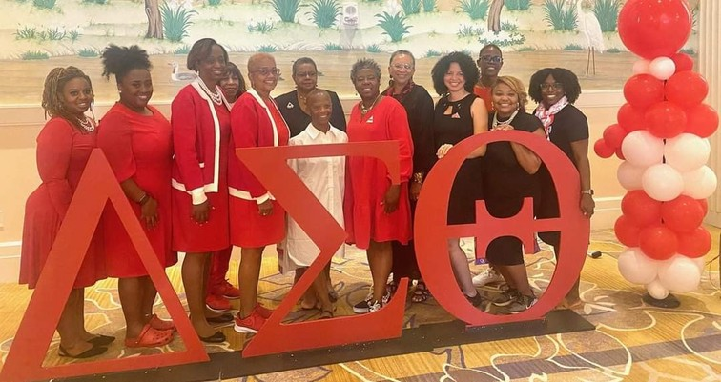
Things That I Enjoy Today My family
Comfortable life style Successful career
Being a Faithful Servant Watching basketball Watching television Living my best life

Slide 15
What Would I Tell My Young Self
Be kind to others
Be respectful
Always be your best self
The sky is the limit
Surround yourself with people that have your best interest at heart

Slide 16
Assignment
Create your identity map.
Write your name in the center of the paper and from there place your identities all around your name. Be creative. Feel free to draw, color, list, etc.
Write a letter to your future self.
In the letter hold yourself accountable to goals and dreams by being specific with what you hope to be doing in a few months. For example, you want to be able to run 3 miles instead of 1 mile; or you want to read 2 books or try 4 new healthy recipes. In 3 months reread your letter to see if you accomplished your goal.

Slide 17
Announcements
Congratulations to our new Officers
Eli Jackson, President – Senior, Avalon High School
Aaron Johnson Jr., 1st Vice President – Junior, Gaithersburg High School
Kobina Asafu-Adjaye, Secretary – Senior, Richard Montgomery High School
National Museum of African American History – Oct 16 – 8:30 am departure
Game Changer Impact Conference for Males – Oct 22 – University at Shady Grove – 8:00 am – 12:30 pm
ACT Test – Oct 22
MuNu Chapter of Omega Psi Phi Essay Due – Oct 21
SAT Test – Nov 5
HBCU College Fair – Nov 5 – Mt Calvary Baptist Church – 10:00 am – 2:00 pm

